Slide 1
Preparing your sponsored projects for promotion & tenure
May 2026
Hansa Magee, PhD
Director, Research Analytics
Division of Research
Brenda Cook
Administrative Consultant
Office of the Provost

Slide 2
Content
Timeline
Call letter
Sponsored projects data in Peoplesoft
Data for P&T
Self-service reports
Common issues and resolutions
Q&A

Slide 3
Timeline
Provost deadlines are noted in the Provost call letter. Department/college deadlines are internally set.
Colleges/schools set their own deadlines (usually in August). Case is locked at this point.
Sponsored projects data first available in April
- sent to department contacts
- Monthly updates available by 3rd week of each month through Dec
Provost office deadline
Dec 15 - TTT
Mar 1 - NTT
Faculty are encouraged to submit addendums until final decisions

Slide 4
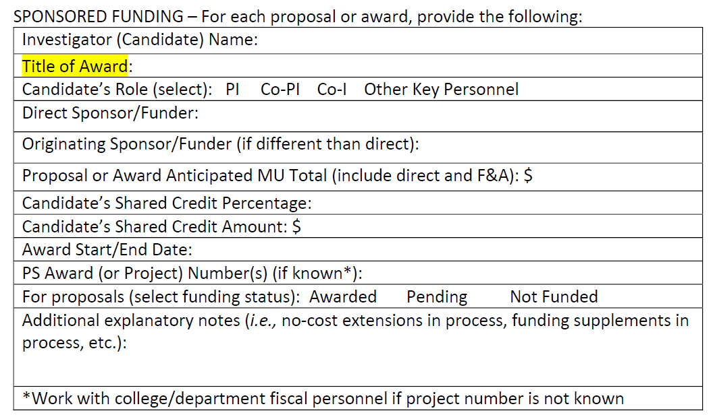
Call letter
https://provost.missouri.edu/promotion-and-tenure/call-letter/

Slide 5
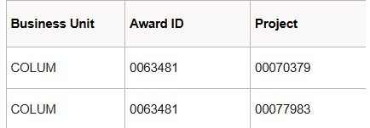
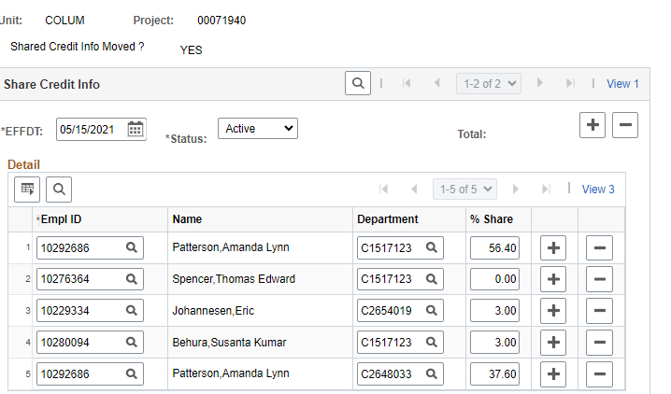
Sponsored Projects
Sponsored project data are administered in Peoplesoft
Each award may have multiple projects attached to it
Shared credit investigators are indicated on the project, not award
Can change over time
00070379
12345678 Baxter, Buster
12345678 Baxter, Buster
87654321 Read, Arthur
87654321 Read, Arthur
12348765 Barnes, Binky
Notes:
Point out:
Multiple project IDs
One emplid multiple departments, can be multiple %
Effective date. Can change over time

Slide 6
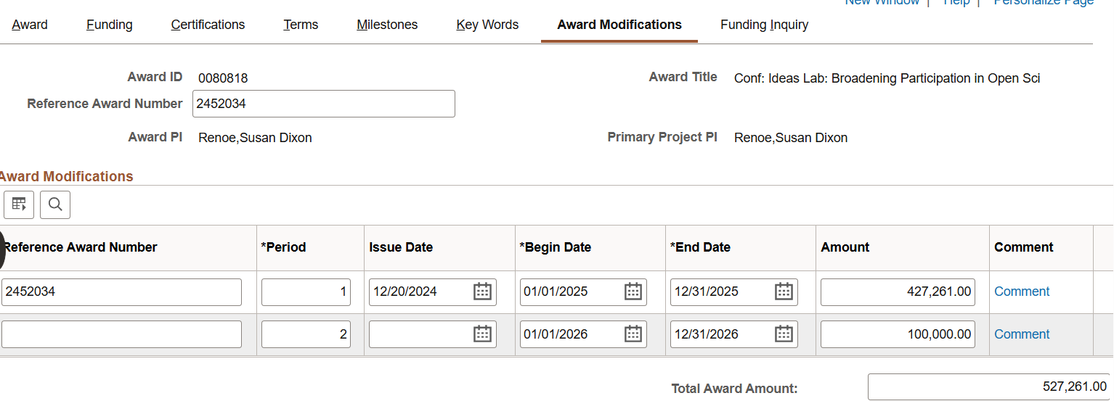
Sponsored Projects – Issue Date
0001111
Conf: Let’s all talk about Harry Potter
1234567
Tiger, Truman
Tiger, Truman
1234567
Notes:
HOWEVER, funding is at the AWARD level. Those funds can come in one lump sum or spread out over time.
Issue date, award period, total anticipated, total obligated (to-date)

Slide 7
Sponsored Projects
https://provost.missouri.edu/promotion-and-tenure/call-letter/
Notes:
Talk through some terminology

Slide 8

Awards Spreadsheet
Dates are of entire award, awarded to-date. End date is for current funding period.
Shared credit is provided by project
Shared credit $ is based on shared credit % Anticipated $ is TOTAL award, including funds not issued yet
1
2
3
00070001
00070001
00070002
00070002
Updated once a month – there likely will not be any changes from month to month.

Slide 9
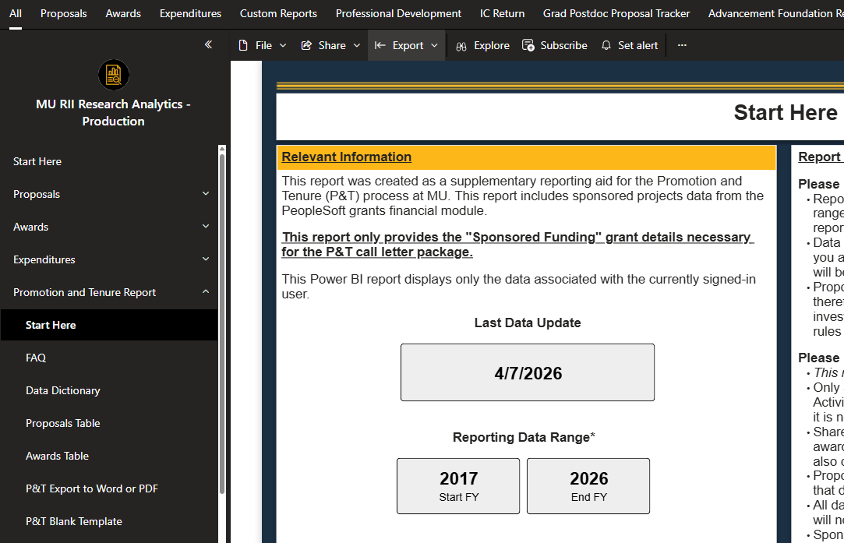
Power BI Report
App.powerbi.com Sign in with your UM credentials
Access MU RII Research Analytics – Production
Power BI is a visualization software from Microsoft. Anyone at UM can create their own Power BI reports. You are accessing the RII RA reporting “folder”.

Slide 10
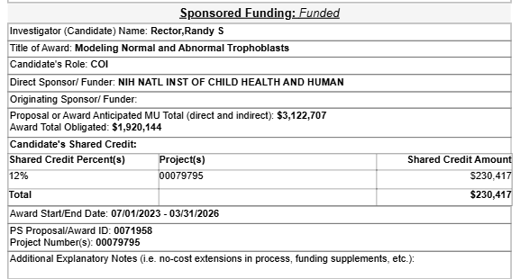
Filling out your P&T sponsored tables
Awards with multiple projects/obligations/shared credit changes, you will need to sum up your shared credit.
Your anticipated $ may not match the award total obligated if you are expending additional funds in the future.

Slide 11
Commonly encountered issues
A proposal/award is missing
  Not in reporting time frame (FY17 - Present). “Present” means through last month.
  Your name is not included in shared credit project(s) – contact your department sponsored projects staff to correct.
  You were added to shared credit after funds were awarded – contact your department sponsored projects staff to correct.
My role (PI, co-PI) is missing or incorrect – contact your department sponsored projects staff to correct.
Proposal status is incorrect (usually from pending to denied) - contact your department sponsored projects staff to correct.
Just funded award is missing. Mostly likely in “pre-award” stage and will be included next month.

Slide 12
Your questions?
Questions: researchanalytics@missouri.edu

