Slide 1
HOW TO USE THESE SLIDES
BRANDED POWERPOINT
Review the slides for inspiration and tips.
Delete and/or copy slides to create your own presentation.
Replace photos as needed and insert your own content.
Do not change the fonts used in this template.
If you have questions, email identity@missouri.edu

Slide 2

ADD YOUR PRESENTATION HEADLINE HERE
Use this area for additional text or information. To change the photo, right click on it and select ‘change picture’.

Slide 3

SECTION HEADER GOES HERE
SECTION/HEADER

Slide 4

HEADLINES IN ARIAL (ALL CAPS)
24 – 18 PT, 1 OR 2 LINES
SECTION/HEADER
Add text and images about your topic and any other information you need to share with your audience.
Change photos by selecting one, right clicking and choose ‘change photo’.

Slide 5
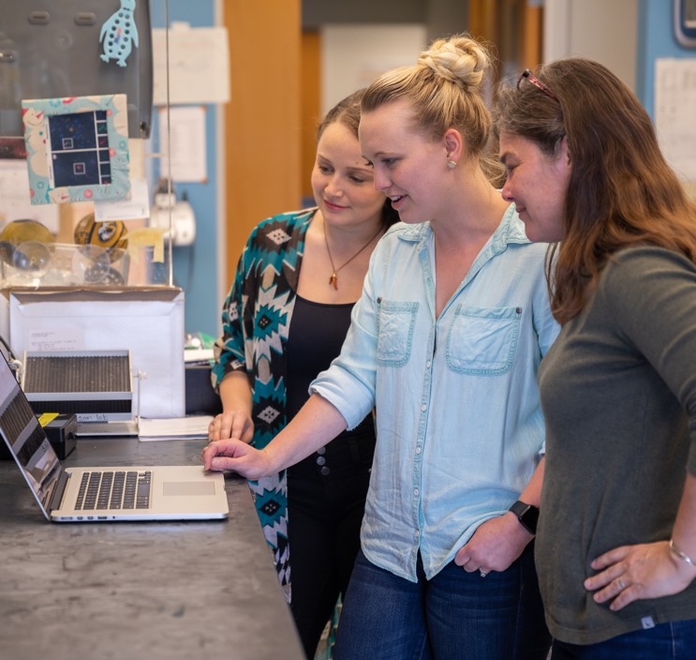
HEADLINES IN ARIAL (ALL CAPS)
24 – 18 PT, 1 OR 2 LINES
SECTION/HEADER
Edit the main header and secondary header to fit the information on each slide.
Change the photo on the right by right clicking on it and selecting “Change Picture”.
Add a description about the photo or additional information here.

Slide 6
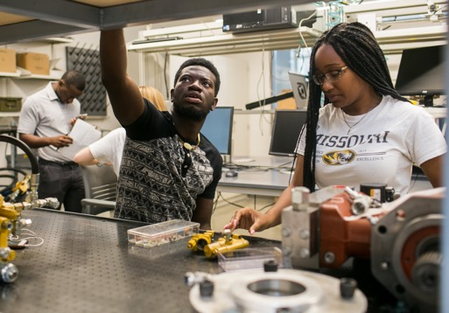


SECTION/HEADER
Add a description about your photo or content here.
Change the photos by selecting one, right clicking and choosing ‘Change Photo’.

Slide 7

Add your content here

Slide 8
HEADLINES IN ARIAL (ALL CAPS)
24 – 18 PT, 1 OR 2 LINES
SECTION/HEADER
Here is a large space to fill with content to wow your audience.
If you need inspiration, visit identity.missouri.edu for helpful tips for creating headlines and copy in the Mizzou brand voice.

Slide 9
HEADLINES IN ARIAL (ALL CAPS)
24 – 18 PT, 1 OR 2 LINES
SECTION/HEADER
Secondary Headline
Secondary Headline
Add text about your topic and any other information you need to share with your audience.
Add text about your topic and any other information you need to share with your audience.

